Slide 1
Scheme For FARMERS
Group Members:-
Sneha Malav
Hansie George
Virendra Kumawat
Akanksha Bhat

Slide 2
Abstract :
In this application there are two users:Farmer and Bidder who will simply login with their credentials that they have entered during the registration process. If the user is a first time user then they will have to register first and provide the necessary information.
Once the user logs in to the system their respective homepages will be visible.
Farmer can (i)Place Sell Requests
(ii)View Sold Crop History
(iii)View Market Place

Slide 3
Assumptions :
We have to assume that the user has basic understanding of an online examination environment.
The user enters proper login credentials.
If the user is not a first time user then he/she should have been already been registered with the system and if the user is a first time user then he/she has to register first in order to take test.

Slide 4
Scope of the project :
Online Examination System is designed for Educational institutes, Training centers , Company recruitments etc.
The system handles all the operations and generates reports as soon as the exam finishes.
The type of questions are only MCQ’s.

Slide 5
Technologies Used:-
Spring
Hibernate
javaScript
jQuery
Eclipse
Tomcat
Spring MVC
Git

Slide 6
Project Differentiator and Highlights :
The main thing that differentiates our project from other online examination system is the ease of use that is to say it very easy to use and straight forward with very less complexity on the view level.

Slide 7
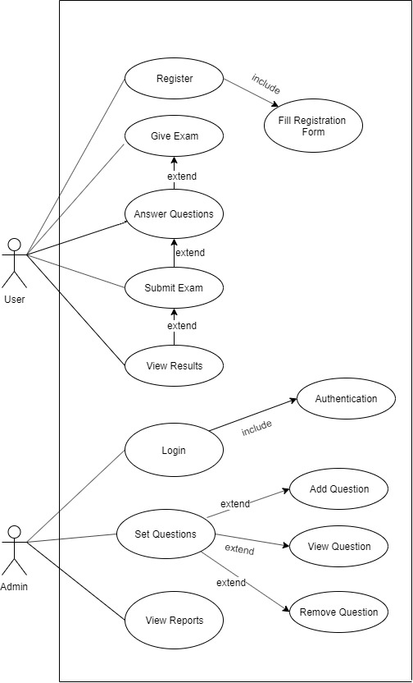

Usecase Diagram :

Slide 8
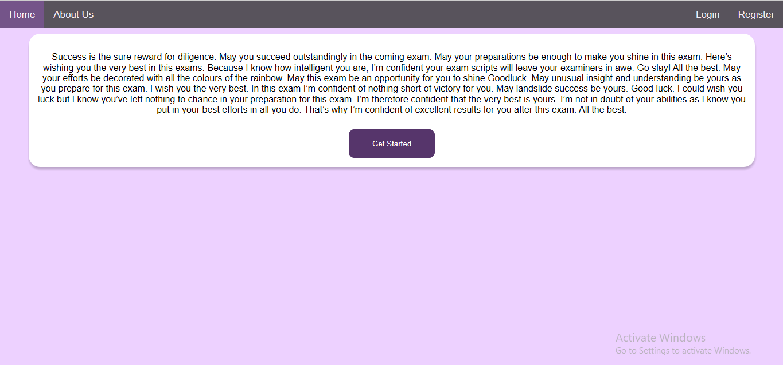
Snapshots :
Welcome Page

Slide 9
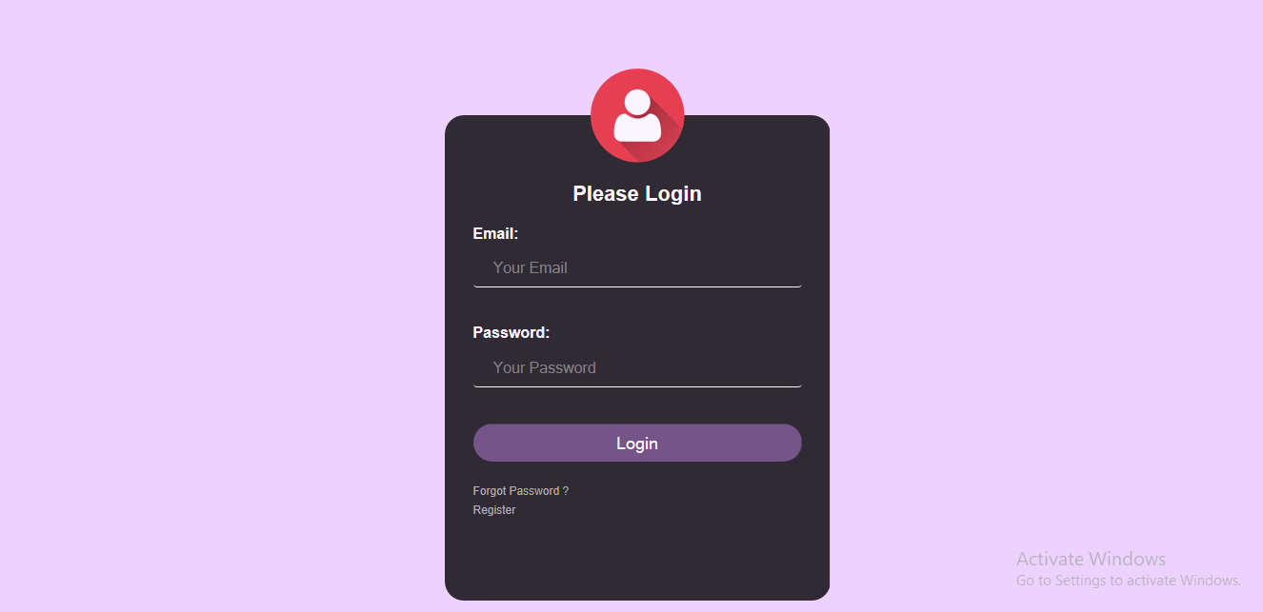
Snapshots :
Login Page

Slide 10
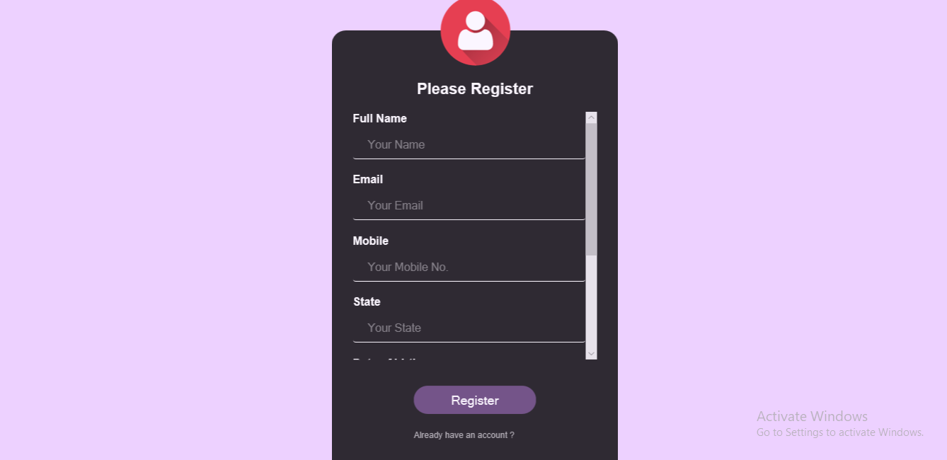
Snapshots :
Register Page

Slide 11
Future Scope :
In future we can also set the difficulty level to be adaptive i.e with every right answer the difficulty of the next question will increase and with every wrong answer the difficulty of the next question will decrease.
We can also include negative marking to make the exam more competitive.
We can also integrate feature that will prevent the user from navigating away from the exam window.
We can also generate questions in such a way that the questions and their options would be visible to the user in a randomized manner so that no 2 users will get same questions at same time and even if they get same questions the options would be randomized.

Slide 12
We would like to take a moment and thank each and everyone of the learning and development team for imparting us with all the knowledge that was required for making this project. Special thanks to Majrul sir for supporting us at each and every step and help us overcome any and all obstacles that we faced and Santosh sir for providing the necessary support whenever needed and lastly we would like to thank Dinesh sir for the encouragement that he provided everytime. Without collective efforts we would have not been able to make this project.
THANK YOU

